Slide 1
Viral Oncology
Principles of Medical Virology - Chapter 7

Slide 2
Cancer
Known medically as a malignant neoplasm;
A broad group of various diseases, all involving unregulated cell growth.
In cancer, cells divide and grow uncontrollably, forming malignant tumors, and invade nearby parts of the body.
The cancer may also spread to more distant parts of the body through the lymphatic system or bloodstream.
Not all tumors are cancerous. Benign tumors do not grow uncontrollably, do not invade neighboring tissues, and do not spread throughout the body.

Slide 3
Determining what causes cancer is complex.
Many things are known to increase the risk of cancer, including tobacco use, certain infections, radiation, lack of physical activity, poor diet and obesity, and environmental pollutants. These can directly damage genes or combine with existing genetic faults within cells to cause the disease.
Approximately five to ten percent of cancers are entirely hereditary.
Cancer can be detected in a number of ways, including the presence of certain signs and symptoms, screening tests, or medical imaging.
Once a possible cancer is detected it is diagnosed by microscopic examination of a tissue sample.

Slide 4
Cancer is usually treated with chemotherapy, radiation therapy and surgery.
The chances of surviving the disease vary greatly by the type and location of the cancer and the extent of disease at the start of treatment.
While cancer can affect people of all ages, and a few types of cancer are more common in children, the risk of developing cancer generally increases with age.
In 2007, cancer caused about 13% of all human deaths worldwide (7.9 million).
Rates are rising as more people live to an old age and as mass lifestyle changes occur in the developing world

Slide 5
Signs and symptoms - Local Effects
Local symptoms may occur due to the mass of the tumor or its ulceration.
For example, mass effects from lung cancer can cause blockage of the bronchus resulting in cough or pneumonia,
Esophageal cancer can cause narrowing of the esophagus making it difficult or painful to swallow,
Colorectal cancer may lead to narrowing or blockages in the bowel resulting in changes in bowel habits.
Masses of breast or testicles may be easily felt.
Ulceration can cause bleeding which, if it occurs in the lung, will lead to coughing up blood, in the bowels to anemia or rectal bleeding, in the bladder to blood in the urine, and in the uterus to vaginal bleeding.
Although localized pain may occurs in advanced cancer, the initial swelling is usually painless. Some cancers can cause build up of fluid within the chest or abdomen.

Slide 6
Systemic symptoms
General symptoms occur due to distant effects of the cancer that are not related to direct or metastatic spread. These may include: unintentional weight loss, fever, being excessively tired, and changes to the skin.
Leukemias, and cancers of the liver or kidney can cause a persistent fever of unknown origin.
Specific constellations of systemic symptoms, termed paraneoplastic phenomena, may occur with some cancers. Examples include the appearance of myasthenia gravis 重症肌无力 in thymoma 胸腺瘤 and clubbing 杵状膨大 in lung cancer.

Slide 7
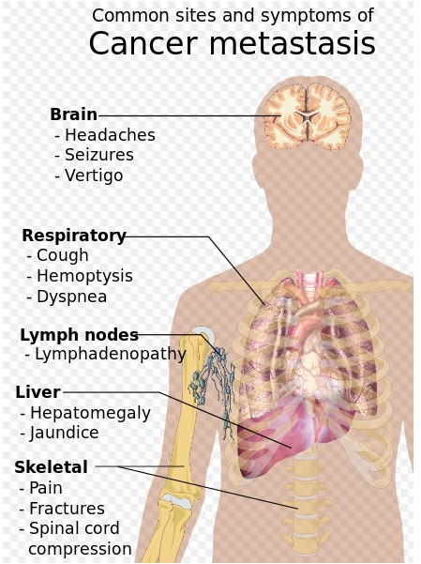
Metastasis
Symptoms of metastasis are due to the spread of cancer to other locations in the body.
They can include enlarged lymph nodes (which can be felt or sometimes seen under the skin and are typically hard), hepatomegaly (enlarged liver) or splenomegaly (enlarged spleen) which can be felt in the abdomen, pain or fracture of affected bones, and neurological symptoms.

Slide 8
Causes - Heredity
The vast majority of cancers are non-hereditary ("sporadic cancers").
Hereditary cancers are primarily caused by an inherited genetic defect.
Less than 0.3% of the population are carriers of a genetic mutation which has a large effect on cancer risk and these cause less than 3–10% of all cancer.
Some of these syndromes include: certain inherited mutations in the genes BRCA1 and BRCA2 with a more than 75% risk of breast cancer and ovarian cancer,
Hereditary nonpolyposis colorectal cancer (HNPCC or Lynch syndrome) which is present in about 3% of people with colorectal cancer.

Slide 9
Chemicals
Cancer pathogenesis is traceable back to DNA mutations that impact cell growth and metastasis.
Substances that cause DNA mutations are known as mutagens, and mutagens that cause cancers are known as carcinogens.
Particular substances have been linked to specific types of cancer. Tobacco smoking is associated with many forms of cancer, and causes 90% of lung cancer.
Many mutagens are also carcinogens, but some carcinogens are not mutagens.
Alcohol is an example of a chemical carcinogen that is not a mutagen.
In Western Europe 10% of cancers in males and 3% of cancers in females are attributed to alcohol.

Slide 10
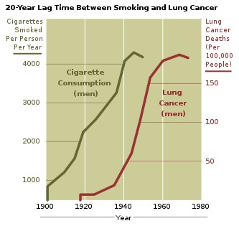
Tobacco
Decades of research has demonstrated the link between tobacco use and cancer in the lung, larynx, head, neck, stomach, bladder, kidney, esophagus and pancreas.
Tobacco smoke contains over fifty known carcinogens, including nitrosamines 亚硝胺 and polycyclic aromatic hydrocarbons 多环芳烃.
Tobacco is responsible for about one in three of all cancer deaths in the developed world, and about one in five worldwide.
Lung cancer death rates in the United States have mirrored smoking patterns

Slide 11
Diet and exercise
Diet, physical inactivity, and obesity are related to approximately 30–35% of cancer deaths.
In USA, excess body weight is associated with the development of many types of cancer and is a factor in 14–20% of all cancer deaths.
Physical inactivity is believed to contribute to cancer risk not only through its effect on body weight but also through negative effects on immune system and endocrine system.
Diets that are low in vegetables, fruits and whole grains, and high in processed or red meats are linked with a number of cancers.
This may partly explain differences in cancer incidence in different countries for example gastric cancer is more common in Japan with its high salt diet and colon cancer is more common in the United States.
Immigrants develop the risk of their new country, often within one generation, suggesting a substantial link between diet and cancer.

Slide 12
Radiation
Up to 10% of invasive cancers are related to radiation exposure;
Medical use of ionizing radiation is a growing source of radiation-induced cancers;
Prolonged exposure to ultraviolet radiation from the sun can lead to melanoma and other skin malignancies;
radio frequency radiation from mobile phones, electric power transmission, and other similar sources have been described as a possible carcinogen by the World Health Organization

Slide 13
Physical agents
Some substances cause cancer primarily through their physical, rather than chemical, effects on cells.
A prominent example of this is prolonged exposure to asbestos, naturally occurring mineral fibers which are a major cause of mesothelioma 间皮瘤, a type of lung cancer.
Nonfibrous particulate materials that cause cancer include powdered metallic cobalt and nickel, and crystalline silica.
Usually, physical carcinogens must get inside the body (such as through inhaling tiny pieces) and require years of exposure to develop cancer

Slide 14
Hormones
Some hormones play a role in the development of cancer by promoting cell proliferation.Hormones are important agents in sex-related cancers such as cancer of the breast, endometrium 子宫内膜, prostate, ovary, and testis, and also of thyroid cancer and bone cancer.
An individual's hormone levels are mostly determined genetically, so this may at least partly explains the presence of some cancers that run in families that do not seem to have any cancer-causing genes.
For example, the daughters of women who have breast cancer have significantly higher levels of estrogen and progesterone than the daughters of women without breast cancer. These higher hormone levels may explain why these women have higher risk of breast cancer, even in the absence of a breast-cancer gene.

Slide 15
Infection
Worldwide approximately 18% of cancer deaths are related to infectious diseases.
This proportion varies in different regions of the world from a high of 25% in Africa to less than 10% in the developed world.
Viruses are the usual infectious agents that cause cancer but bacteria and parasites may also have an effect.
A virus that can cause cancer is called an oncovirus.
These include human papillomavirus (cervical carcinoma), Epstein-Barr virus (B-cell lymphoproliferative disease and nasopharyngeal carcinoma), Kaposi's sarcoma herpesvirus (Kaposi's Sarcoma and primary effusion lymphomas), hepatitis B and hepatitis C viruses (hepatocellular carcinoma), and Human T-cell leukemia virus-1 (T-cell leukemias).
Bacterial infection may also increase the risk of cancer, as seen in Helicobacter pylori-induced gastric carcinoma.
Parasitic infections strongly associated with cancer.

Slide 16
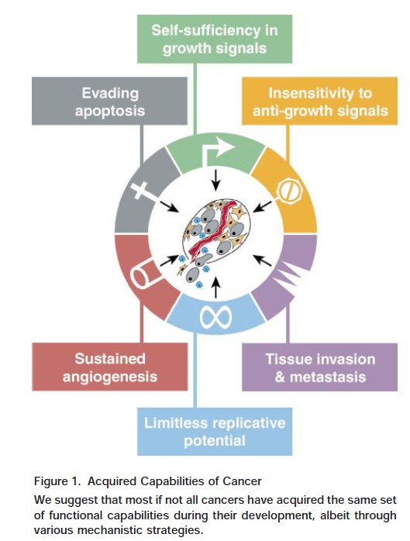
Hallmarks of Cancer

Slide 17
Self-sufficiency in growth signals
Normal cells require external growth signals (growth factors) to grow and divide. These signals are transmitted through receptors that pass through the cell membrane. When the growth signals are absent, they stop growing.
Cancer cells can grow and divide without external growth signals. Some cancer cells can generate their own growth signals. For example, glioblastomas can produce their own platelet-derived growth factor (PDGF), and sarcomas can produce their own tumor growth factor α (TGF-α).
Receptors themselves can be overexpressed. For example, the epidermal growth factor receptor (EGF-R/erbB) is overexpressed in stomach, brain and breast cancers, while the HER2/neu receptor is overexpressed in stomach and breast cancer. Or, mutated receptors can send signals without any growth factors at all.

Slide 18
Insensitivity to anti-growth signals
Cancer cells are generally resistant to growth-preventing signals from their neighbours.
The growth of normal cells is kept under control by growth inhibitors in the surrounding environment, in the extracellular matrix and on the surfaces of neighboring cells. These inhibitors act on the cell cycle clock, by interrupting cell division (mitosis) in the interphase

Slide 19
Evading apoptosis
Apoptosis is a form of programmed cell death (cell suicide), the mechanism by which cells are programmed to die in the event they become damaged. Cancer cells characteristically are able to bypass this mechanism.
Apoptosis can be triggered by an overexpressed oncogene, and this may be the primary means by which such mutant cells are continually removed. Conversely, cancer cells must overcome apoptosis to progress.

Slide 20
Limitless reproductive potential
Non-cancer cells die after a certain number of divisions. Cancer cells escape this limit and are apparently capable of indefinite growth and division (immortality). But those immortal cells have damaged chromosomes, which can become cancerous.
Mammalian cells have an intrinsic program, the Hayflick limit, that limits their multiplication to about 60-70 doublings, at which point they reach a stage of senescence.
The counting device for cell doublings is the telomere, which loses DNA at the tips of every chromosome during each cell cycle. Many cancers involve the upregulation of telomerase, the enzyme that maintains telomeres.

Slide 21
Sustained angiogenesis
Angiogenesis is the process by which new blood vessels are formed. Cancer cells appear to be able to kickstart this process, ensuring that such cells receive a continual supply of oxygen and other nutrients.
Cancer cells initially lack angiogenic ability, limiting their ability to expand. In order to progress, they must develop a blood supply

Slide 22
Tissue invasion and metastasis
Cancer cells can break away from their site or organ of origin to invade surrounding tissue and spread (metastasize) to distant body parts.

Slide 23
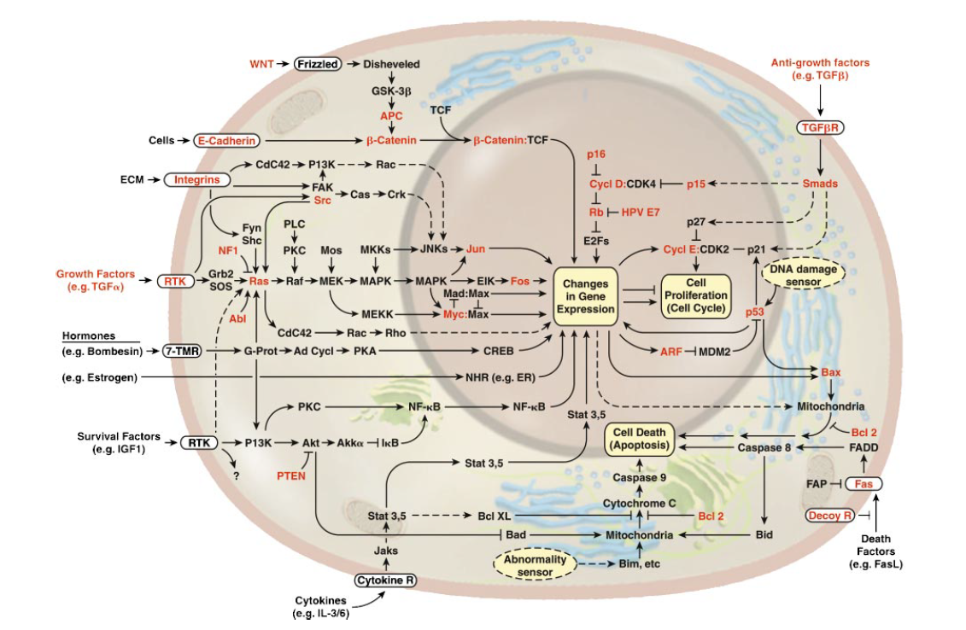

Slide 24
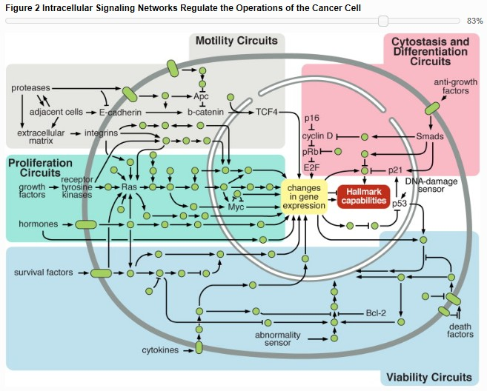

Slide 25
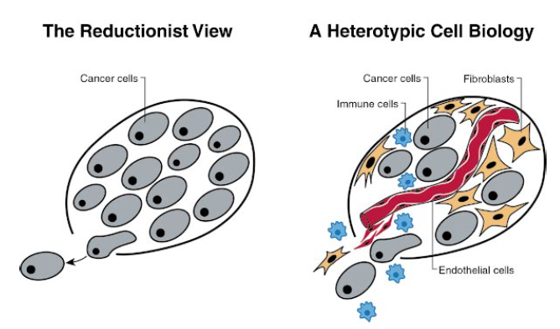

Slide 26
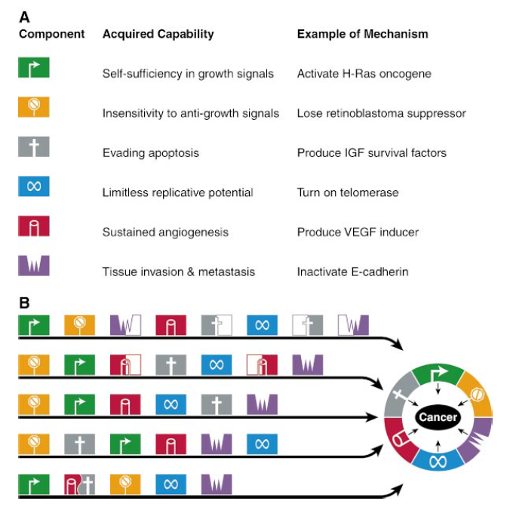

Slide 27
Updates - 2010
In his 2010 NCRI conference talk, Hanahan proposed four new hallmarks:
Deregulated metabolism: most cancer cells use abnormal metabolic pathways to generate energy, a fact appreciated since the early twentieth century, but only now gaining renewed research interest.
Evading the immune system: cancer cells appear to be invisible to the body’s immune system.
Unstable DNA: cancer cells generally have severe chromosomal abnormalities, which worsen as the disease progresses.
Inflammation: recent discoveries have highlighted the role of local chronic inflammation in inducing many types of cancer.

Slide 28
Oncovirus

Slide 29
Viral Oncogenesis
Cancer is a genetic disease
Oncogenesis comprises the processes of multi-step mutations, resulting in uncontrolled cell growth, increasing disorganization of cells and ultimately cancer.
Epigenetic factors also play important roles
Target of tumor viruses (oncoviruses): tumor suppressor genes and oncogenes

Slide 30
Hallmarks of Cancer

Slide 31
Oncovirus
An oncovirus is a virus that can cause cancer.
This term originated from studies of acutely-transforming retroviruses in the 1950–60s, often called oncornaviruses to denote their RNA virus origin.
It now refers to any virus with a DNA or RNA genome causing cancer and is synonymous with "tumor virus" or "cancer virus".
The vast majority of human and animal viruses do not cause cancer, probably because of long-standing coevolution between the virus and its host.

Slide 32
Oncovirus-induced cancer
Worldwide, the WHO International Agency for Research on Cancer estimated that in 2002 17.8% of human cancers were caused by infection
11.9% being caused by one of seven different viruses.
The importance of this is that these cancers might be easily prevented through vaccination (e.g., papillomavirus vaccines), diagnosed with simple blood tests, and treated with less-toxic antiviral compounds.

Slide 33
Generally, tumor viruses cause little or no disease after infection in their hosts, or cause non-neoplastic diseases such as acute hepatitis for hepatitis B virus or mononucleosis 单核血球增多症 for Epstein-Barr virus.
A minority of persons (or animals) will go on to develop cancers after infection. This has complicated determining whether or not a given virus causes cancer.

Slide 34
Different forms of oncoviruses
Tumor viruses come in a variety of forms:
Viruses with a DNA genome, such as adenovirus
Viruses with an RNA genome, like the Hepatitis C virus (HCV)
Retroviruses having both DNA and RNA genomes: Human T-lymphotropic virus (HTLV) and hepatitis B virus (HBV), which normally replicates as a mixed double and single-stranded DNA virus but also has a retroviral replication component.

Slide 35
In many cases, tumor viruses do not cause cancer in their native hosts but only in dead-end species.
For example, adenoviruses do not cause cancer in humans but are instead responsible for colds, conjunctivitis 结膜炎 and other acute illnesses. They only become tumorigenic when infected into certain rodent species, such as Syrian hamsters.
Some viruses are tumorigenic when they infect a cell and persist as circular episomes or plasmids, replicating separately from host cell DNA (Epstein-Barr virus and Kaposi's sarcoma-associated herpesvirus).
Other viruses are only carcinogenic when they integrate into the host cell genome as part of a biological accident, such as polyomaviruses and papillomaviruses.

Slide 36
Viral Oncogenesis of Retroviruses
Transducing and non-transducing oncoviruses
Transducing: cause cancer early (in days in chicken) and 100% efficiency
Non-transducing: cause cancer within weeks or months. Non-transducing oncovirus cannot transform culture cells
The 3rd group: months to years development of cancer

Slide 37
Transducing oncovirus and v-oncogenes
Transducing oncoviruses contain transduced cellular genes which becomes oncogenes and would cause cancer very rapidly;
Non-transducing oncovirus does not contain v-oncogenes
V-oncogenes' counterpart in cells are called c-oncogenes or proto-oncogenes
Non-transducing oncovirus can initiate integration of the provirus adjacent to a c-oncogene to cause tumor

Slide 38
Oncogenes
Oncogenes encode components of celllar signal transduction
Their activation leads to a constitutive growth signal
In 1980s, virologists found tumor suppressor genes which can be inhibited by viral proteins
Viral oncology studies significantly controbuted for the understanding of basic mechanisms of oncogenesis

Slide 39
Mechanisms of viral oncogenesis
A direct oncogenic viral mechanism involves either insertion of additional viral oncogenic genes into the host cell or to enhance already existing oncogenic genes (proto-oncogenes) in the genome.
Indirect viral oncogenicity involves chronic nonspecific inflammation occurring over decades of infection, as is the case for HCV-induced liver cancer.
These two mechanisms differ in their biology and epidemiology: direct tumor viruses must have at least one virus copy in every tumor cell expressing at least one protein or RNA that is causing the cell to become cancerous.

Slide 40
Because foreign virus antigens are expressed in these tumors, persons who are immunosuppressed such as AIDS or transplant patients are at higher risk for these types of cancers.
Chronic indirect tumor viruses, on the other hand, can be lost (at least theoretically) from a mature tumor that has accumulated sufficient mutations and growth conditions (hyperplasia) from the chronic inflammation of viral infection.
In this latter case, it is controversial but at least theoretically possible that an indirect tumor virus could undergo "hit-and-run" and so the virus would be lost from the clinically diagnosed tumor.

Slide 41
Timeline of Discovery
1908: Oluf Bang and Vilhelm Ellerman, U of Copenhagen, first demonstrated that avian leukosis virus could be transmitted after cell-free filtration to new chickens, causing leukemia.
1910: Peyton Rous at Rockefeller extended Bang and Ellerman's experiments to show filtrable cell-free transmission of a solid tumor sarcoma to chickens.
1933: Richard Edwin Shope discovered cottontail rabbit papillomavirus or Shope papillomavirus, the first mammalian tumor virus.
1936: Mouse mammary tumor virus shown by John J. Bittner to be an "extrachromosomal factor" (i.e., virus) transmitted among laboratory strains of mice by breast feeding.[6] This was an extension of work on murine breast cancer caused by a transmissible agent as early as 1915, by A.F. Lathrop and L. Loeb.

Slide 42
1954: Ludwik Gross, working at the Bronx VA medical center isolated murine polyomavirus causing a variety of salivary gland and other tumors in specific strains of newborn mice. This was not widely appreciated until the results were confirmed by scientists at NIH reproducing the experiments under the same conditions.
1961: Simian Vacuolating virus 40 (SV40) discovered by Eddy at NIH, and Hillman and Sweet at Merck laboratory. Several years later it was shown to cause cancer in Syrian hamsters, raising alarm that persists today. Scientific consensus now strongly agrees that this is not likely to cause human cancer although the controversy still persists.

Slide 43
Human Oncoviruses
1964: Anthony Epstein, Bert Achong and Yvonne Barr identify the first human cancer virus from Burkitt lymphoma cells. A herpesvirus, this virus is formally known as human herpesvirus 4 but more commonly called Epstein-Barr Virus or EBV.
mid-1960s: Baruch Blumberg first physically isolated and characterized Hepatitis B while at NIH and later Fox Chase Laboratory, receiving the 1976 Nobel Prize in Medicine or Physiology. Although this agent was the clear cause of hepatitis and might contribute to liver cancer hepatocellular carcinoma, this link was not firmly established until epidemiologic studies were performed in the 1980s by R. Palmer Beasley and others.
1980: Human T-lymphotropic virus 1 (HTLV I), the first human retrovirus was discovered by Bernard Poiesz and Robert Gallo at NIH and Mistuaki Yoshida and coworkers in Japan.
1984–86: Harald zur Hausen, together with Lutz Gissman, discovered first HPV16 and then HPV18 responsible for approximately 70% of cervical cancers. For discovery that human papillomaviruses (HPV) cause human cancer, zur Hausen won a 2008 Nobel Prize.

Slide 44
1987: HCV was discovered by panning a cDNA library made from diseased tissues for foreign antigens recognized with patient sera. This work was performed by Michael Houghton at Chiron, a biotechnology company, and D.W. Bradley at CDC. HCV was subsequently shown to be a major contributor to liver cancer (hepatocellular carcinoma) worldwide.
1994: Patrick S. Moore and Yuan Chang (a husband and wife team then at Columbia University) working together with Frank Lee and Ethel Cesarman isolated Kaposi sarcoma-associated herpesvirus (KSHV or HHV8). This search was prompted from work by V. Beral, T. Peterman and H. Jaffe who showed from accumulating evidence from the epidemic of Kaposi sarcoma associated with AIDS, that this cancer must have another infectious cause besides HIV itself. This agent was predicted to be a new virus. Subsequent studies revealed that KSHV is indeed the "KS agent" and is responsible for the epidemiologic patterns of KS and related cancers.
2008: Chang and Moore, now at the University of Pittsburgh Cancer Institute, developed a new method to identify cancer viruses based on computer subtraction of human sequences from a tumor transcriptome, called digital transcriptome subtraction (DTS).

Slide 45
DNA oncoviruses
Human papilloma virus (HPV), a DNA virus, causes transformation in cells through interfering with tumor suppressor proteins such as p53. Interfering with the action of p53 allows a cell infected with the virus to move into a different stage of the cell cycle, enabling the virus genome to be replicated. Forcing the cell into the S phase of the cell cycle could cause the cell to become transformed. Some types of HPV increase the risk of, e.g., cervical cancer.
Kaposi's sarcoma-associated herpesvirus (KSHV or HHV-8) is associated with Kaposi’s sarcoma, a type of skin cancer.
Epstein-Barr virus (EBV or HHV-4) is associated with four types of cancers
Merkel cell polyomavirus – a polyoma virus – is associated with the development of Merkel cell carcinoma
Human cytomegalovirus (CMV or HHV-5) is associated with mucoepidermoid carcinoma 粘液表皮样癌 and possibly other malignancies.

Slide 46
关于查找感兴趣的实验室的文献
PI本人网页或Lab website
PubMed (http://www.ncbi.nlm.nih.gov/pubmed/ OR www.pubmed.gov)
Google Scholar (http://scholar.google.com)

